Slide 1
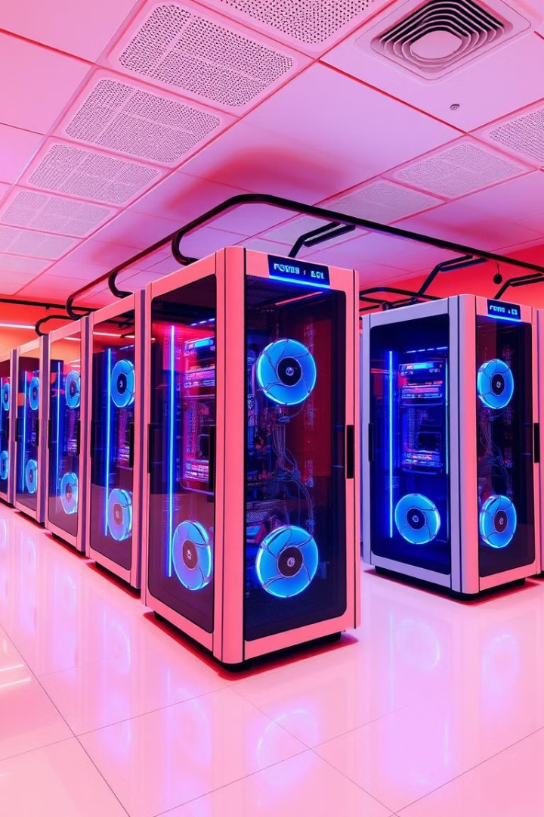
Gaming System
Team Leader:- Arnab Paul(22CS8051)
Team Members:-
Saptak Chakrabarti(22CS8052) Soumojit Dutta(22CS8056)
Sushmita Khatun(22CS8053) Y.Anand Reddy(22CS8057)
Baidurjya Sinha(22CS8054) Rohit Sharma(22CS8058)
N.Yashwanth Reddy(22CS8055) Dinesh Kumar Goud(22CS8059)
Ishani Sarkar(22CS8060)

Slide 2
Client-Server Architecture
Server Responsibilities
Client Connectivity
Communication Protocol
The server will handle user authentication, game state management, and turn coordination.
Clients will connect to the server from different terminals, logging in and making game moves.
The server and clients will communicate using sockets in C, with the server listening for and facilitating client connections.

Slide 3
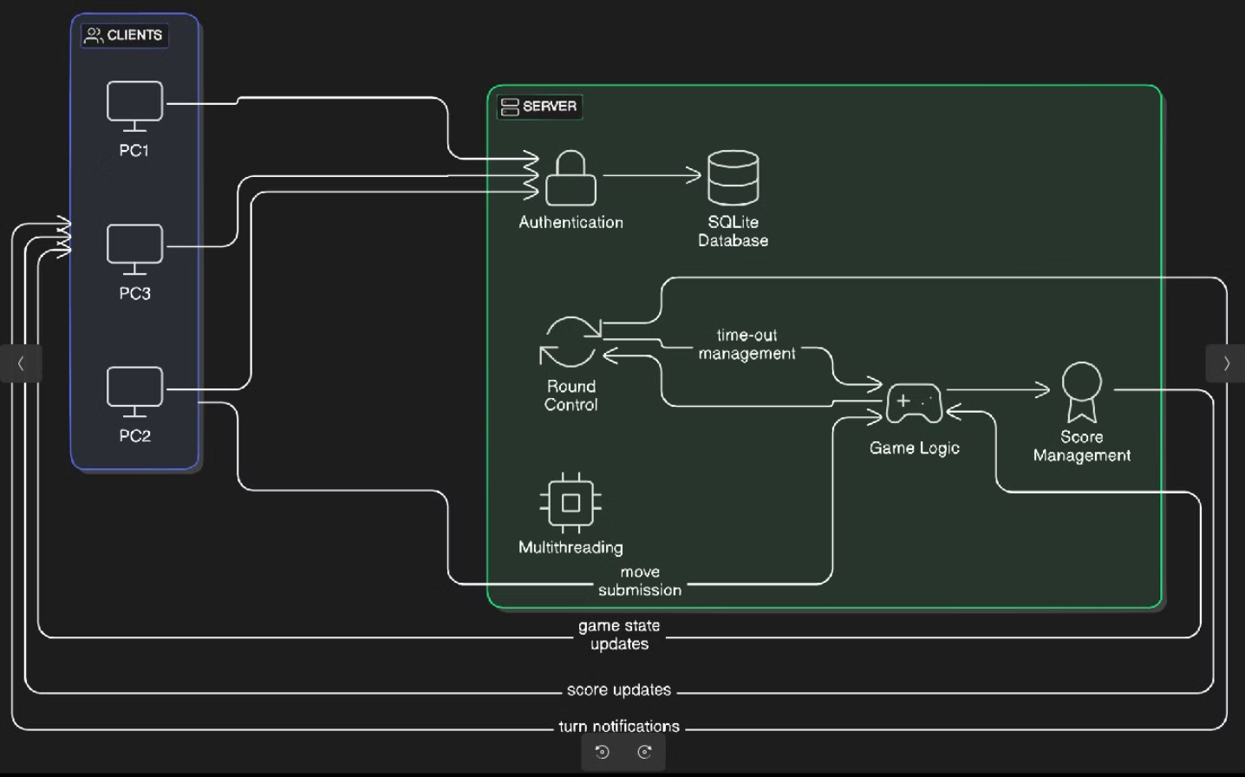
Client-Server Architecture Breakdown

Slide 4
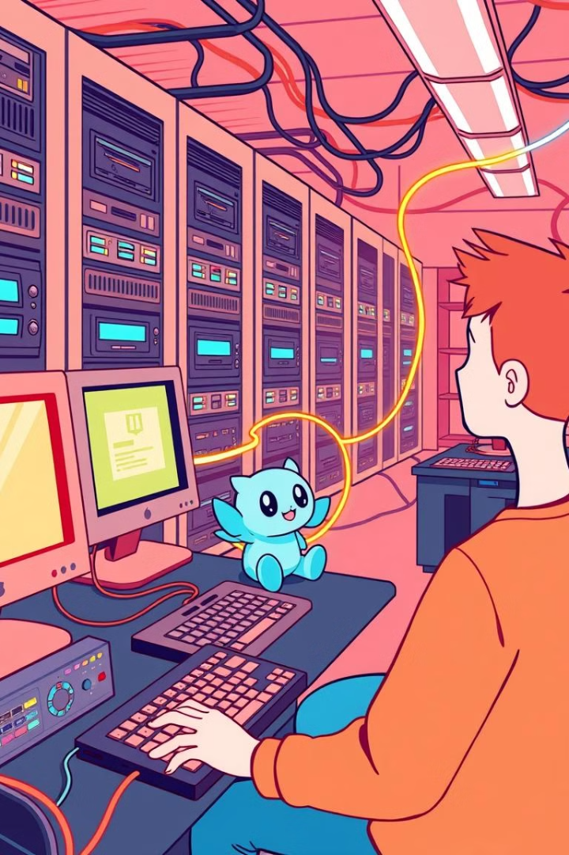
Server Functionality
1
Authentication
2
Game State
The server will be responsible for verifying user credentials and managing secure login sessions.
The server will maintain the current state of the game, including player positions, scores, and other critical data.
3
Turn Management
The server will coordinate the game turns, ensuring a smooth and synchronized gameplay experience.

Slide 5
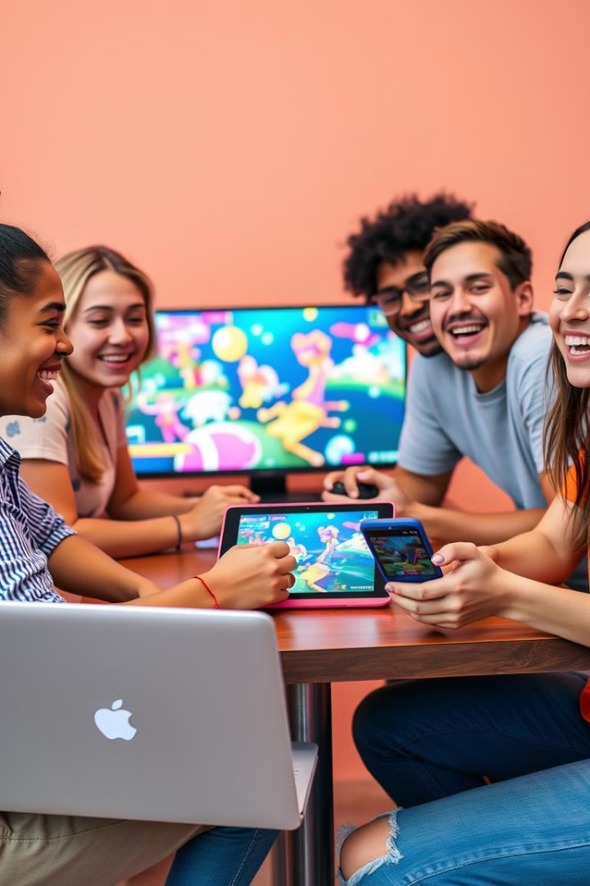
Client Connectivity
1
Login
Clients will connect to the server and authenticate with their credentials.
2
Gameplay
Clients will interact with the game, making moves and updates that are relayed to the server.
3
Coordination
The server will manage the clients' actions, ensuring a synchronized and fair gameplay experience.

Slide 6
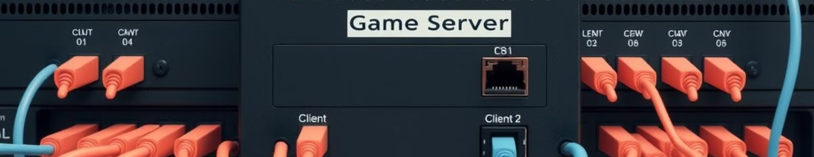
Networking with Sockets
Socket Creation
Connection Handling
Data Transfer
The server will create and bind a socket to listen for incoming client connections.
The server will accept client connections and manage their sessions using the socket API.
Clients and the server will exchange game-related data, such as player actions and updates, through the socket interface.

Slide 7
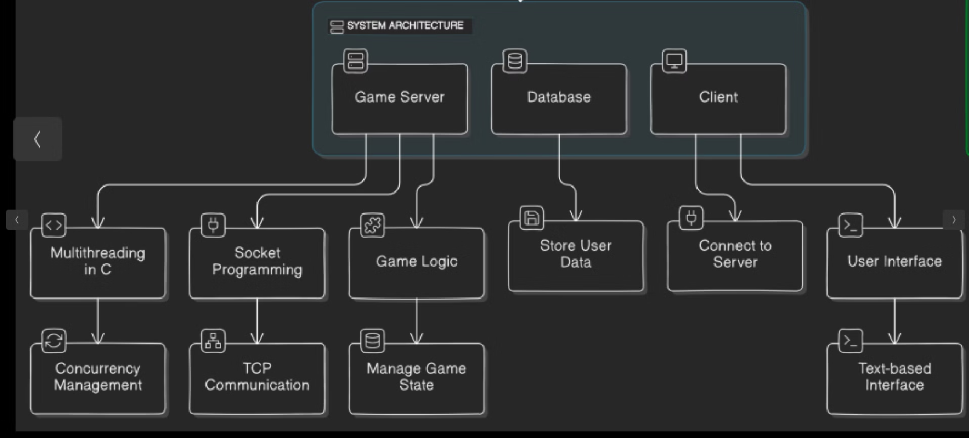
Components Flowchart

Slide 8
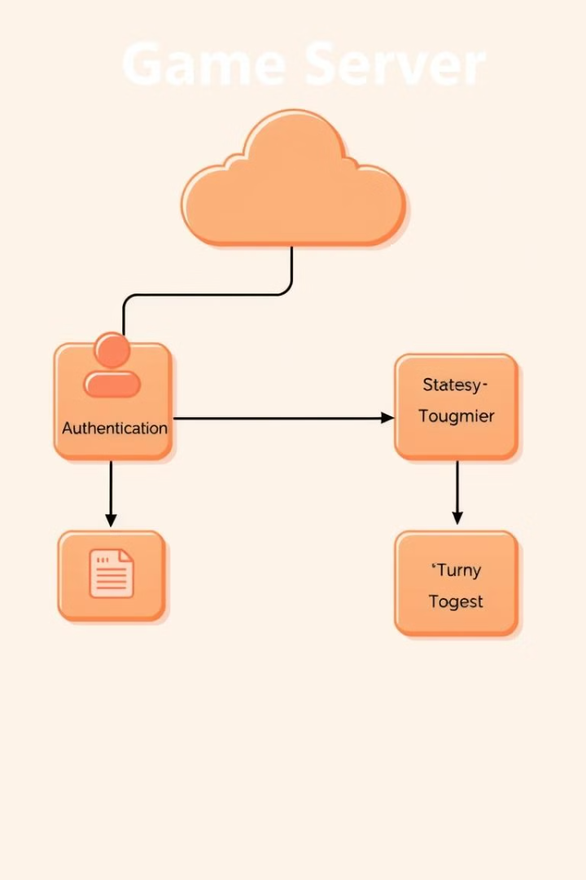




Components Overview
Authentication
Game State
Secure user login and session management.
Maintaining the current state of the game.
Turn Management
Networking
Coordinating player turns and moves.
Facilitating client-server communication.

Slide 9
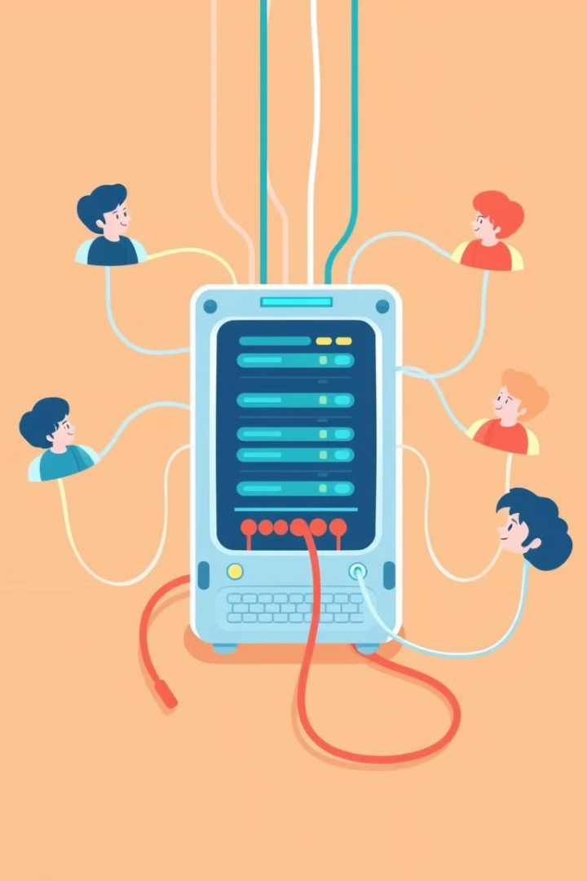

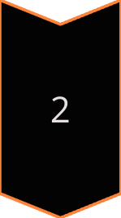
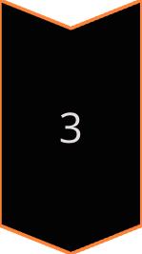
Game Server (C-based)
Thread Pooling
The server will use POSIX threads (pthread.h) to create a pool of worker threads to handle multiple client connections.
Connection Management
Each client connection will be assigned to a dedicated worker thread, which will manage the client's gameplay and interactions.
Synchronization
The worker threads will coordinate with the main server thread to ensure synchronized game state updates and turn processing.

Slide 10
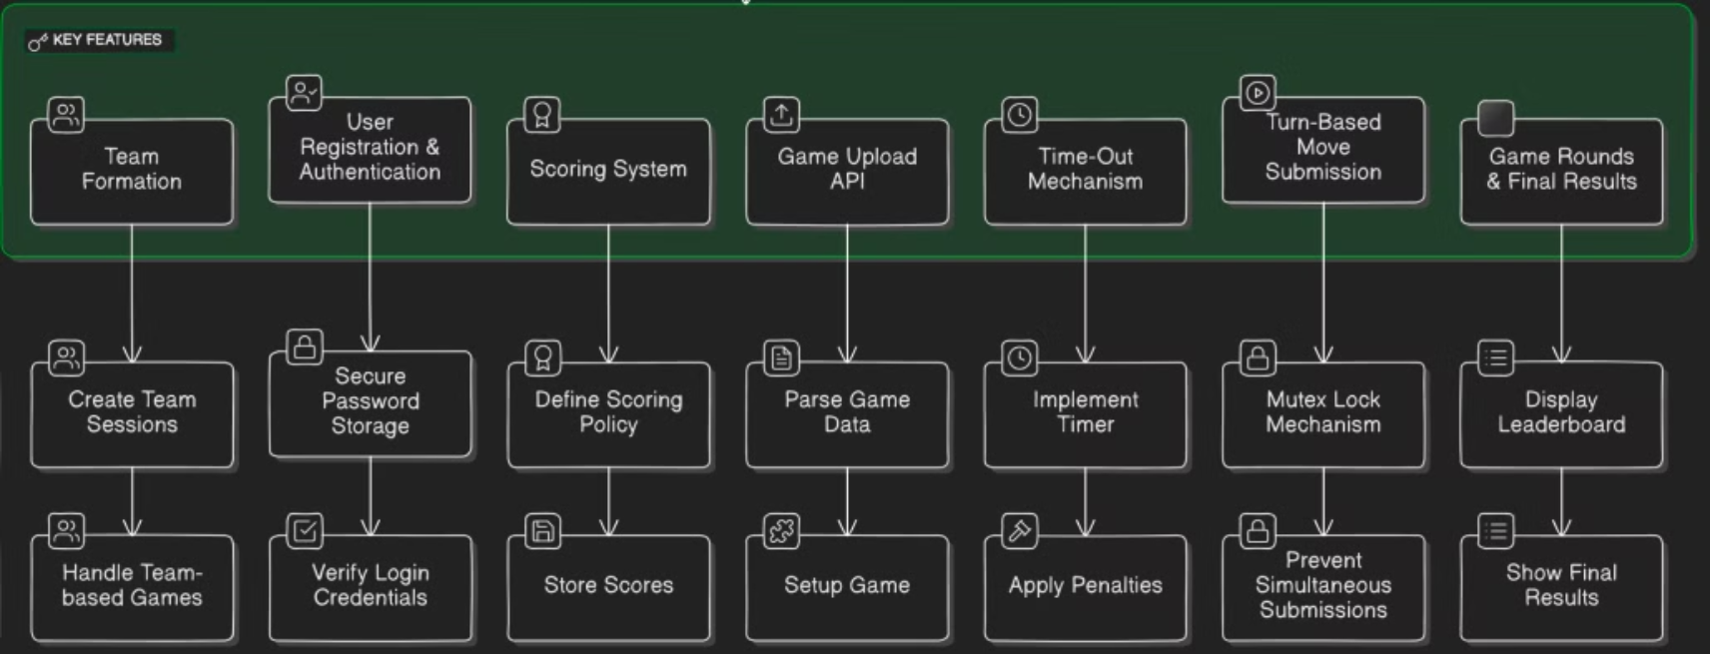
Key Features

Slide 11
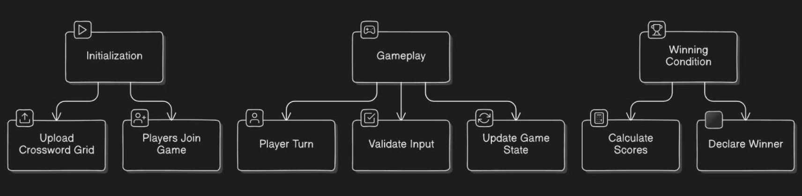
Game Mechanism

Slide 12
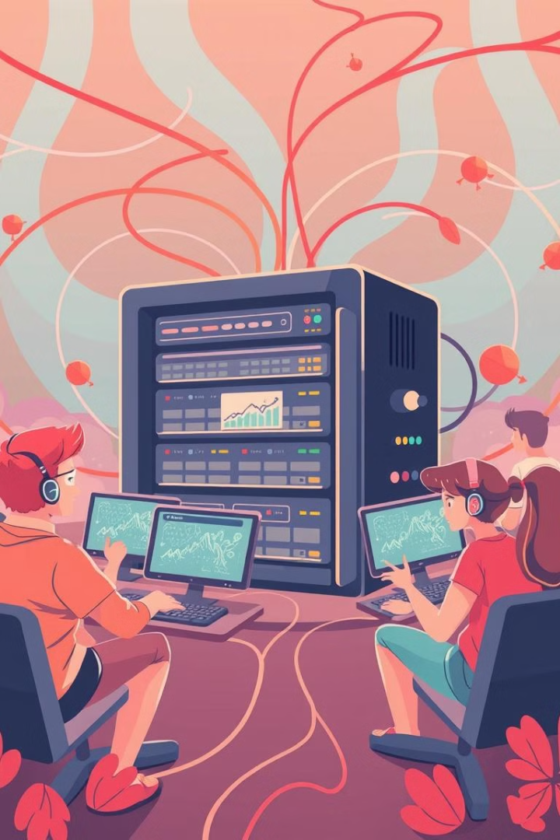
Conclusion
By leveraging a client-server architecture and utilizing C-based multithreading, the game server will be able to efficiently handle multiple client connections, manage game state, and facilitate a smooth and synchronized gameplay experience.

